Slide 1


Raising Awareness – using the Functional Fitness MOT
Professor Dawn Skelton
Glasgow Caledonian University
& Later Life Training
Notes:
The purpose of this presentation is to raise awareness of the background, purpose and potential of the Functional Fitness Tool as a means of raising awareness of the importance of functional Fitness amongst both active ageing and physical activiyt professionals as well as with older people.

Slide 2
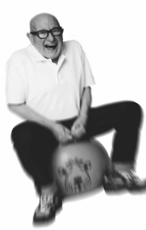
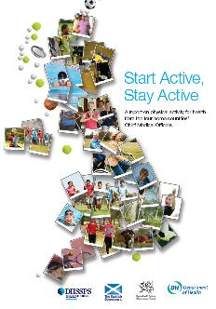
Purpose of the FF MOT
Highlight the UK Physical Activity Guidelines with professionals and older people (65+)
Highlight the importance of the components of fitness, particularly strength and balance and sedentary behaviour
Use as a motivational tool to engage older people in local physical activity programmes and opportunities
Notes:
The purpose of the FF MOT is to
Highlight the importance of the 2011 UK CMO Guidelines for Physical Activity for Older Adults (65+). Published by the Department of Health, they form the basis of physical activity promotion, programming and advice for people over the age of 65.
The UK CMO Guidelines highlighted in particular, the importance of maintaining strength and balance in later life as critical to the independence and mobility of older people as well as the need to reduce sedentary behaviour (sitting time) amongst the older population. These three elements are new to physical activity promotion with older people.
Through education and guidance, motivate and encourage older people to take part in safe and purposeful local physical activity opportunities

Slide 3
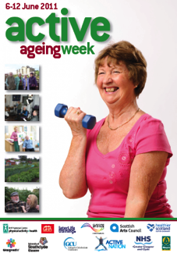




History
Developed in 2011 for the Glasgow Science Festival and Active Ageing Week - Glasgow
Piloted with 60 older people in Govan Shopping Centre and the Arc Leisure Facility at GCU
Launched at the 8th World Congress on Active Ageing (Glasgow), with 250 older people and their carers
Over 700 professionals trained in use
Notes:
The Functional Fitness MOT was designed by Prof. Dawn Skelton at Glasgow Caledonian University, initially as a contribution to the 2011 Glasgow Science Festival and Glasgow’s Active Ageing Week.
After initial pilots in local shopping and leisure centres, the Functional Fitness MOT was launched in 2012 at the 8th World Congress on Active Ageing also in Glasgow attracting over 250 older people and their carers.
Since the summer of 2013, over 700 professionals across the UK (including exercise and fitness teachers, physiotherapists, sports development officers, active ageing officers, health trainers) have been trained to use the Functional Fitness MOT.

Slide 4
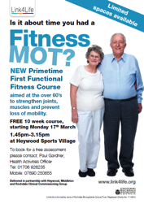

An opportunity for you
Build on your existing work to promote Active Ageing
Awareness raising on the UK CMO Guidelines on Physical Activity for Older Adults (65+)
Functional Fitness MOT events as a contribution to promoting Active Ageing, eg UK Day for Older People (Oct 1st each year)
Notes:
The Functional Fitness MOT can be used in a number of ways to build upon your existing work to promote Active Ageing including targeting new communities and older populations, working with new local partners and educating the Active Ageing workforce.
Since 2013, the Functional Fitness has also been promoted as a contribution to the Department for Work and Pensions’ Older People’s Day . Held each year on October 1st, when across the UK, local organisations hold a range of events to engage older people and communities in festivals, health fairs and come and try it events.

Slide 5
What is functional fitness?
“Functional Fitness performance is having the physiological capacity to perform normal everyday activities safely and independently without undue fatigue”.
(Rikli @ Jones 1999)
Greater priority in later life?
Notes:
Functional fitness shifts the focus of health and physical activity promotion.
It highlights the need, that in addition to the health benefits of physical activity for older people, it is to maintain sufficient strength, balance and endurance to maintain the performance of everyday living, such as rising from a chair, climbing the stairs and walking to the shops.
Research tells us that this(independent living) becomes as if not more important to older people in later life as good health.

Slide 6
Utilising what works
An enjoyable and intriguing activity....what is an MOT for older people?
One to one assessment
Time to
  understand different components of fitness
  discuss barriers, motivators & solutions
  digest personalised information to take away
Follow up information (local) on how to find out more
Normal data sets from large studies
Notes:
An intriguing and enjoyable interactive activity, the Functional Fitness MOT suggests that a check up, to ensure “all the parts are working”, the concept of a regular MOT is one that older people would understand.
It has a sound evidence base in that the process is based upon the concepts of personalisation, tailoring of information and education, assisting with solutions and decision making and offering a choice of local activities and opportunities.
The individual assessments and comparisons with scores of other older people are based upon normative data from studies involving over 10,000 community dwelling older people. (Rikkli and Jones 2006)

Slide 7
What it is NOT
A research tool
A pre-post programme evaluation tool
An alternative to a pre-exercise assessment
An alternative to offering tailored exercise (don’t just assess, do!)
Appropriate for frailer, older people in residential care
Notes:
It is important to be clear however, that the Functional Fitness MOT tool is not designed, nor appropriate for use as
A research tool
A pre-post programme evaluation tool or an alternative to pre-exercise assessment.
Although there is a similarity, the actvities within the Functional Fitness tool do not form an exercise programme
An activity within residential care settings as the data sets do not include scores from frailer, older people, but more importantly, the level of functional ability required to perform that assessment tasks would be greater than that of frailer, older people, exposing them to bot failure and risk.
NB The Functional Fitness MOT might be appropriate as an educational tool for staff who work in residential care settings and their understanding of functional fitness and activities of daily living.

Slide 8
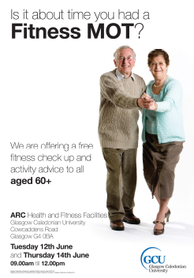
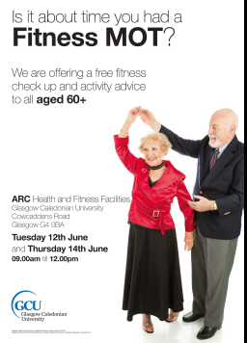
Advertising

Slide 9
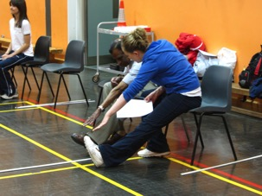
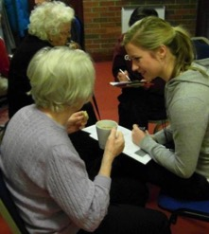
What happens?
Individual FF MOT Assessment
1 – 1 discussion about results, strengths and weaknesses
Tailored guidance on taking action
Take home FF MOT results and action plan
Follow up (if agreed)
Notes:
A brief explanation of what happens during a Functional Fitness MOT activity session.
Local organisers are able to undertake their own promotion and targeting
During the session, participants are individually assessed on a maximum of 9 assessment activities (to be illustrated in next few slides). Following the assessment, they are involved in a 1 – 1 discussion with the assessor about their results, strengths and areas of concern. A conversation can them take place about how the individual might be motivated to take action (ie increase their physical activity, join a group and participants can be signposted to a choice of activities. This may be supported by an action plan.
The FF MOT and any action plan becomes the property of the individual to take home as a record of the assessment.
If agreed (and subject to local data protection procedures) participants can be asked if they would liked to be contacted after a specified period of time to see if taking part in the Functional Fitness MOT has affected their participation in physical activity or helped them in any other way.

Slide 10
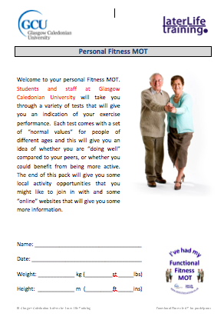
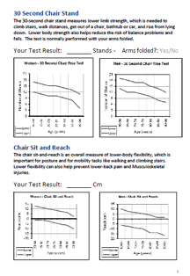
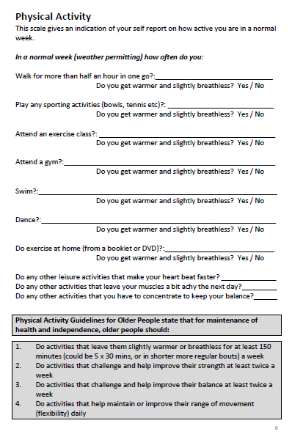
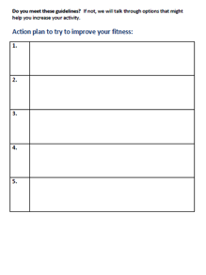
Personalised take home information
Notes:
This is the Functional Fitness MOT tool looks like.
Personal information is inserted at the front and an action plan is at the end. In between are the individual activities where assessment scores are recorded as well as a physical activity questionaire.
There is space provided for the insertion of local information to customise the FF MOT to include physical activity opportunities for each local area/community.
The Functional Fitness tool should always remain the take-home property of the individual participant.

Slide 11
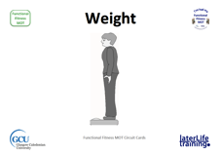
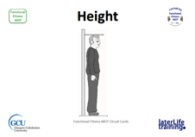
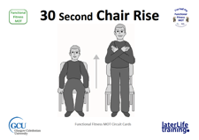
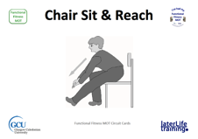
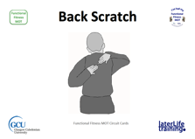
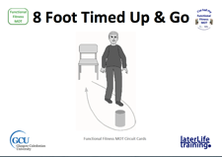
Circuit approach
Lower limb strength & Endurance
Flexibility
Flexibility
Balance
Notes:
Some of the assessments included
In addition to height and weight measures
The 30 second chair rise is an assessment of leg strength and power.
Chair sit and reach, measures hamstring flexibility which aids walking (as well as toe nail cutting!)
Back scratch measures shoulder flexibility, helpful for dressing, stretch up to a high shelf or washing one’s hair
8 foot timed up and go is a measure of leg strength, agility and walking speed.

Slide 12
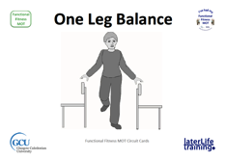
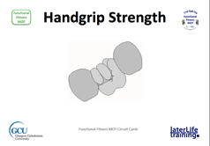
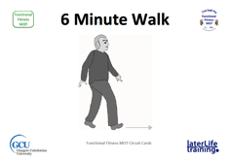
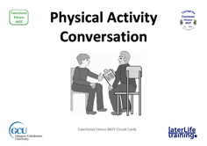
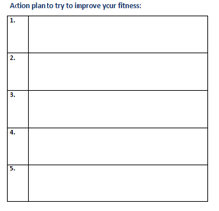
Circuit approach
Balance
Strength
Endurance
Discussion about results and Action Plan
Self reported PA
Personalised Feedback
Notes:
Assessment tasks continues
Single leg balance measures balance performance which assist in mobility and independence, stair use and agility.
Handgrip strength is an indicator of overall body strength, assist with activities requiring grip eg, opening jars and containers and using stair and grab rails.
6 minute walk test assesses walking ability by distance, over time, demonstrating mobility and independence around the house and in the community.
The physical activity questionnaire is used to gather additional information about other activities undertaken by the participant during any week.
The action plan can be used to identify any agreed actions for the individual to make (small) changes as a result of participation in the FF MOT

Slide 13
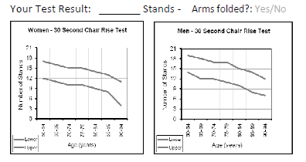
Data compared to “peers”
Each test explains reason
Gender specific
Actual data marked on graph and discussed
Participants do well on some things and not others
12
__
Notes:
Scoring the assessment
Participants are given a reason for the the inclusion of each component of functional fitness, related to everyday living. Eg “the 30 second sit to stand will give you an indication of your upper leg strength, which is important for rising form a chair, using the stairs, stepping on and off a bus.”
For each assessment, there is a separate chart from men and women to reflect gender differences in functional fitness scores and research.
The score is marked on the graph and compared with the normative scores for people of the same age.
Most participants will score well in some areas whilst other scores may not be so good.

Slide 14
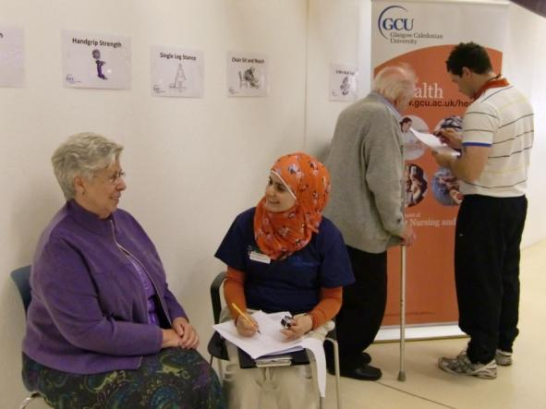
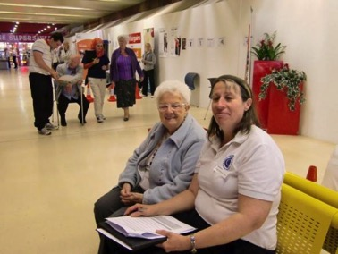
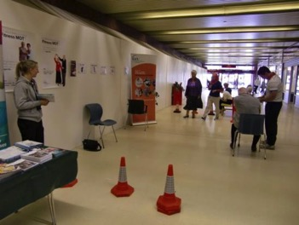
Time to discuss and share
Notes:
After the completion of the assessments, time is set aside in a quiet space for a 1 – 1 conversation about the scores and any actions that might be taken.
These images are from an original pilot taking place in a shopping centre.

Slide 15
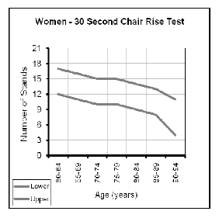
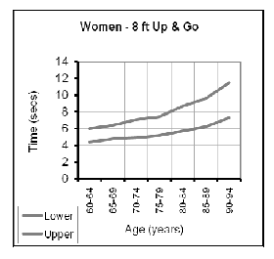
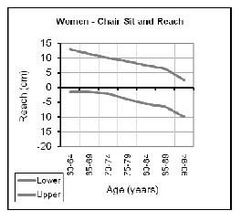
What needs some work and why?
Lower limb strength and stamina not too bad
Balance work needed to reduce risk of falls
Flexibility needs improving for better walking
Notes:
The discussion will focus on the good scores, (to boost confidence) and then areas that might require attention and action

Slide 16
Preferences and opportunities
Indoor or outdoor?
Home or group?
Mixed group or single sex?
Time constrained? Perhaps activities that can be incorporated into daily life (sit to stands during TV adverts, toe raises while waiting for kettle to boil)
Any medical conditions that limit activity or may require specialist advice?
Notes:
The conversation can then continue to considering the different choices and opportunities that might be available if the participant is so motivated by their reflections on their Functional Fitness MOT assessment.
This should be matched with information about local opportunities being provided.

Slide 17
On the day - you will need
Enough copies of Fitness MOT for potential number of participants
Local physical activity co-ordinator to ensure tailored advice
Postural Stability Instructors, physiotherapists and exercise teachers to undertake the FF MOTs
One person with each older person for all tests and discussion
Circuit approach to FF MOT tests
Plenty of local literature on opportunities
Notes:
Some of the planning considerations for the successful running of a Functional Fitness MOT event which will require advanced planning.

Slide 18
Equipment and space needed
Weighing Scales
Height Scale
Handgrip Dynamometer
Stop watch/timer
Tape measure (to measure distance on floor)
Hard long wooden ruler (to measure reach)
Bollards to mark walking routes
Stable chairs without arms
Flat non-slip floor space for walking
Sit down quiet area for discussion
Notes:
An outline of the equipment and space requirements for a Functional Fitness event/activity
Most of the equipment is easy to find and only the handgrip dynamometer might be an additional expenditure.
This ensures that Functional Fitness MOT activities are relatively in-expensive to run, with human resources being the greater consideration.

Slide 19
Other thoughts.....
  Personalised one to one assessment and advice throughout so …..
  Numbers of people needed to run the awareness raising?
Other people delivering the awareness raising?
  Other PA, fitness, health, social care professionals; Peer mentors
Space requirements
Follow up
  Data protection issues vs known benefit of follow up
Notes:
Key consideration is matching the number of participants with sufficient assessors so that everyone gets personal attention (which we know is much valued) and people do not have to wait too long to take part.
A range of other people can assist with the assessments.
If follow up and return activities are planned and agreed, local and organisational data protection procedures will need to be applied.

Slide 20
Case study – Aberdeen City Council, Scotland
Two x one day events – 1st 60, 2nd 90 participants
“Meet the provider” exhibition with focus on
  Keeping eyes, feet and mind healthy
  Preventing falls
  Technology and independence
  Suitable exercise classes, social activities and events
Include health checks eg. Blood Pressure
“Now held every 6 months and additional training across the community to sustain
Notes:
Case studes to illustrate the different applications of the Functional Fitness MOT
Aberdeen City Council have sustained their programme for 3 years.
Beginning with larger city centre “health fairs” reaching up to 90 participants in a day involving a range of local service providers in an exhibition as well as an opportunity to meet local physical activity providers.
These events are held every 6 months and complimented by smaller events in local community halls for those older people who find travelling to the city centre difficult.

Slide 21

Case study – Rochdale
Link4Life exercise programmes
Entry point to one of 3 local 10 week exercise classes
Report personalisation of scores/results improve motivation
Report individual improvements in physical function and daily living (over 10 weeks?)
Participants directed to other forms of activity eg, aqua, yoga, Zumba, walking programmes
Notes:
The Rochdale Link4Life programme use the Functional Fitness MOT as an entry point into local weekly exercise classes.
Based on success and improvements in functional fitness after 10 weeks participants are then directed into other activity groups of choice

Slide 22
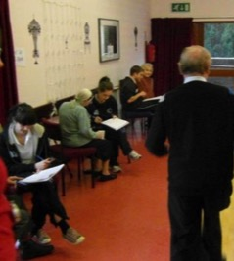
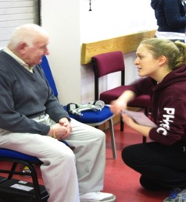
Case study – supported living
Reaching Older Adults in Renfrewshire (Roar) Scotland
27 older volunteers underwent a Functional Fitness MOT facilitated by physiotherapy students
3 month follow up reported individual improvements
Increase in attending ROAR social activity events and getting “Out and About”
Notes:
ROAR is a community based enterprise in Paisley, that runs 10 local Health and Wellbeing clubs for older people at risk of loneliness and isolation.
Following Functional Fitness activities involving physiotherapy students, follow up reported exciting outcomes from the group members.
In addition to improved functional fitness scores, reporter significantly increased participation in community and social events amongst members feeling much more confident to get “out and about”

Slide 23
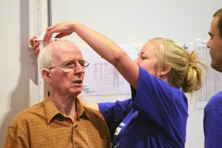
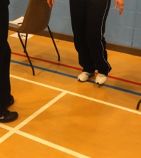
Case study - Local libraries
Whitehaven - Cumbria Partnership NHS Foundation Trust - Physiotherapy Services
Health and Wellbeing FF MOT half-day 9.30 – 2.00
Included Functional Fitness MOTs, BMI and blood pressure checks
273 people attended (aged 49 to 92) 50+ MOTs
15 local organisations attended and supported with information tables and stands
Notes:
Cumbria Physiotherapy services, working with local community partners have run 2 half-day Functional Fitness events making use of local libraries as accessible venues.
The Functional Fitness MOT activities have been supported by a range of other health and wellbeing checks and even in a short space of time, have attracted over 250 people from 49 - 92.

Slide 24
Flexible applications
Options to scale up or down to suit resources
One to one advice and guidance
Smaller/regular ongoing programme (10 – 20)
Large scale event/health fare (50+)
Health trainer workforce
Shopping centres
Parish halls in rural communities
Intergenerational events with FE and HE students
Physiotherapy settings
Notes:
To date, the experience of Later Life Training suggests that the Functional Fitness NMOT can be applied in a variety of settings and be scaled up or down to suit the needs and resources of local services as well as targeting different population, from 1 – 1 assessments to large scale health fair and MOT events.
These activities can also be carried out in a variety of settings in order to reach different groups of older people and many activities supported by either older volunteers or students from Further or Higher Education.

Slide 25
Conclusions
Importance of different components of fitness to health and independence in old age
Awareness raising important but literature alone will not work
Personalising the advice is vital
Important to also raise awareness with other Active Ageing professionals
Notes:
Key elements of why the Functional Fitness =MOT can be effective in local community settings.

Slide 26
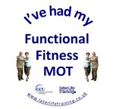

Want to know more - next steps?
Further information and details of all the Functional Fitness MOT resources (MOT tool, circuit cards, protocols and posters) and training days are available from the Later Life Training Website @ www.laterlifetraining.co.uk
Notes:
All the resources required to implement Functional Fitness MOT Activities are available as free downloads from the Later Life Training website as well as details of Functional FitnessCPD training days/activities that are available

